Slide 1

PORTUGAL
Άγγελος Τσάκο
Χρήστος Γιάννογλου

Slide 2
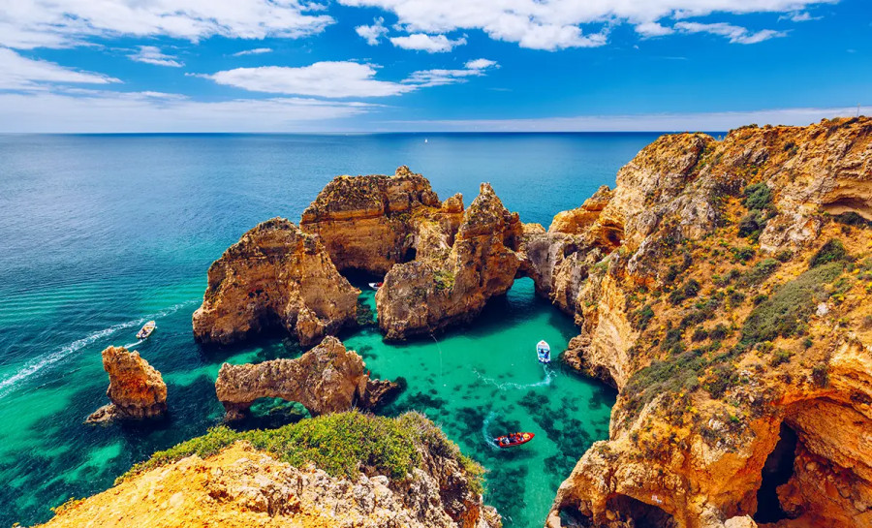
Portugal is a country in southern Europe, bordered by Spain and the Atlantic Ocean. Known for its maritime history, it played a key role in the Age of Discovery. Lisbon, its capital, and Porto, famous for its wine, are popular destinations. The country is known for its beautiful beaches and rich cuisine. Portugal is also admired for its warm climate and vibrant culture, making it a favorite spot for tourists and expats.

Slide 3
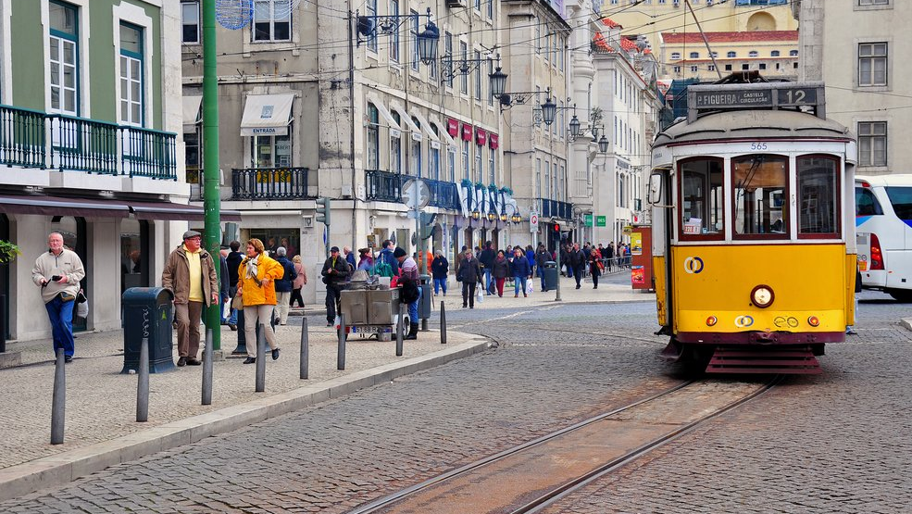
The average temperature in Portugal is 21 °C, which means Portugal is mostly sunny.

Slide 4

Portugal is also known for it’s football players. For example Ruben Dias, Cristiano Ronaldo, Pepe and Bruno Alves are all famous footballers born in Portugal.

Slide 5
Portugal also has beautiful sites, and here are some of them

Slide 6
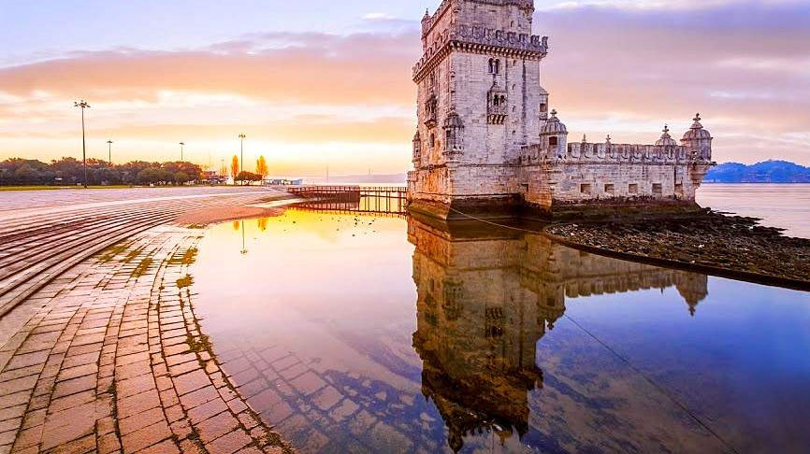
Belém Tower

Slide 7
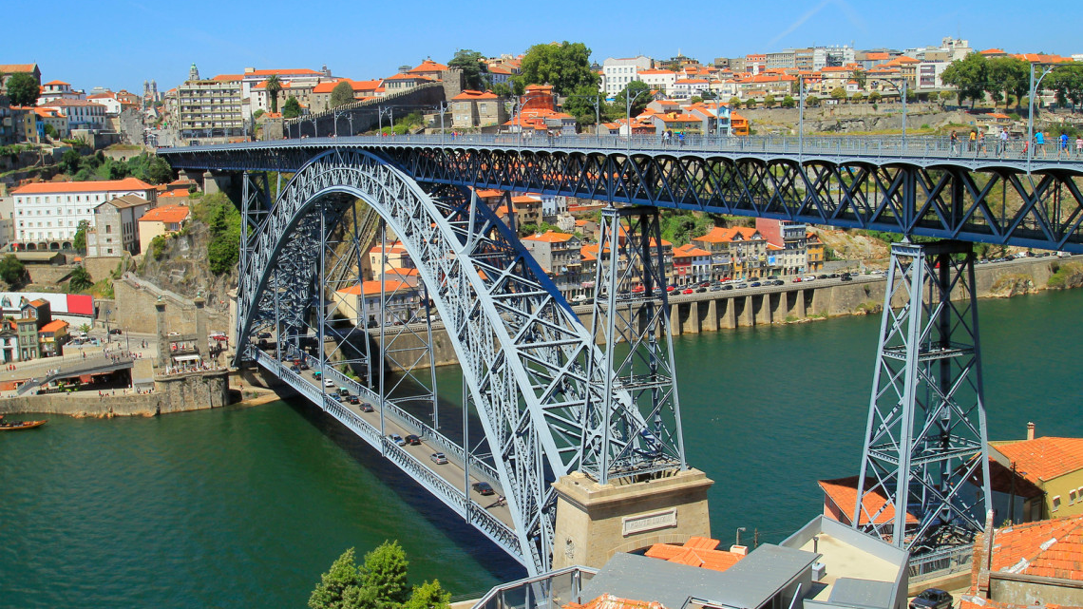
Luís I Bridge

Slide 8
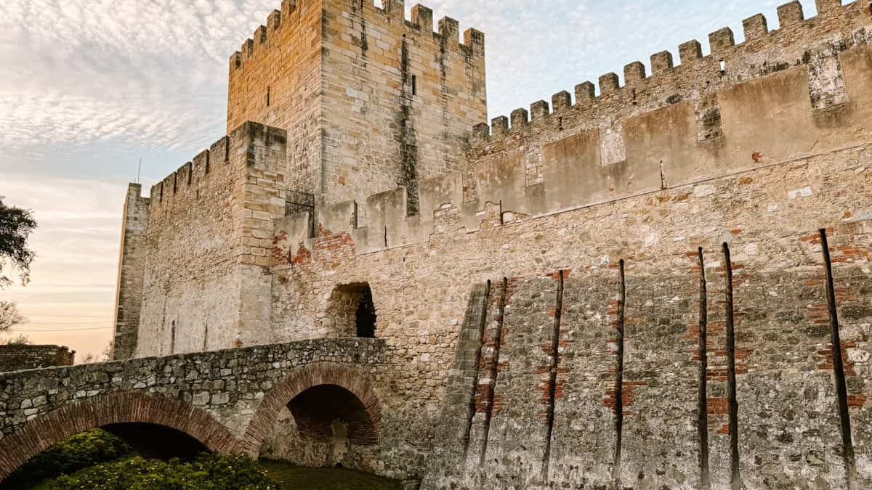
Castelo de SAo Jorge

Slide 9
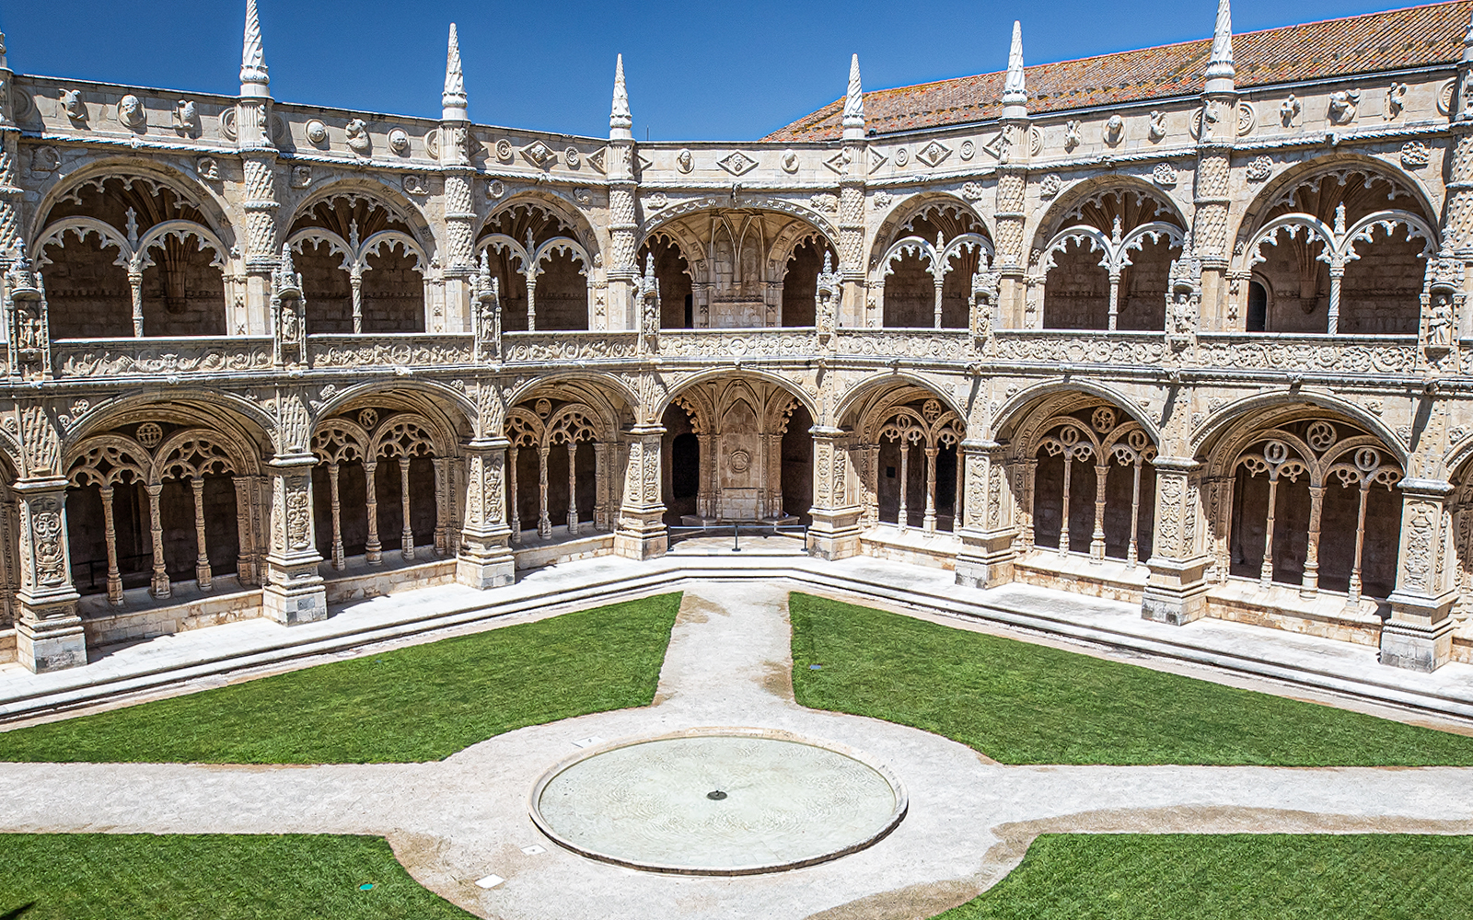
Jerónimos Monastery

Slide 10
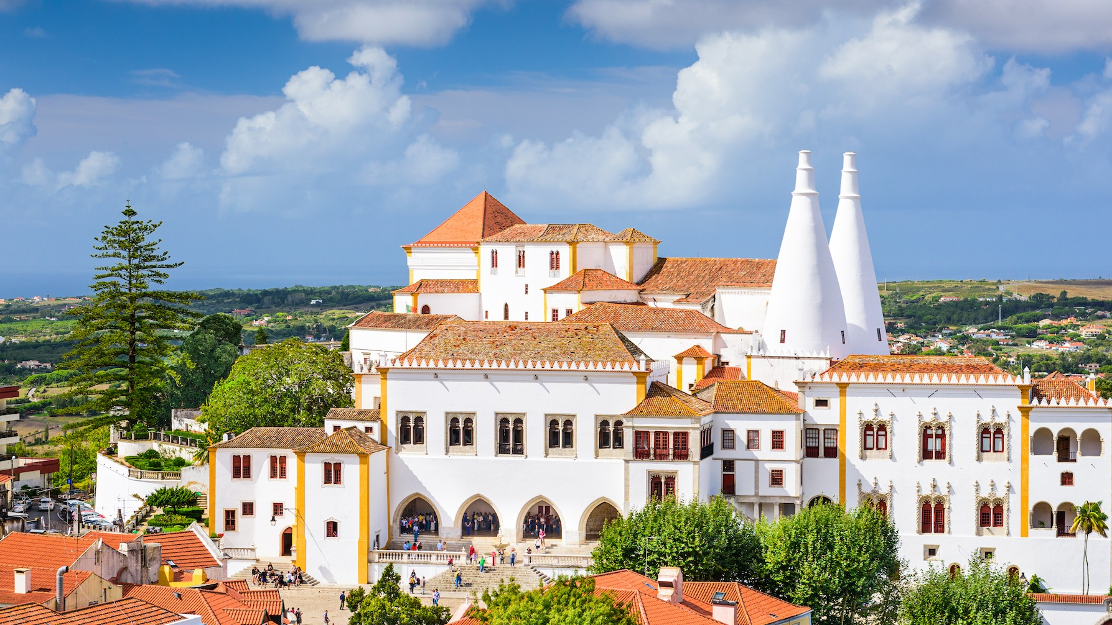
National Palace of Sintra

Slide 11

In conclusion, Portugal's blend of rich history, stunning landscapes, and vibrant culture make it a truly unique destination. Whether exploring the bustling streets of Lisbon, savoring a glass of port in Porto, or enjoying the serene coastline of the Algarve, there's something for everyone in this remarkable country.

